Slide 1

TAJIKISTAN ToURISM

Slide 2

Tourism in Tajikistan offers travelers a wide variety of inspiring natural landscapes, with mountain peaks, alpine meadows, and clear lakes, plus modern cities and ancient ruins that were once part of lost civilizations. Combine interesting excursions to Penjikent, Khujand, Istaravshan and Dushanbe with active adventures in the Pamir Mountains.

Slide 3
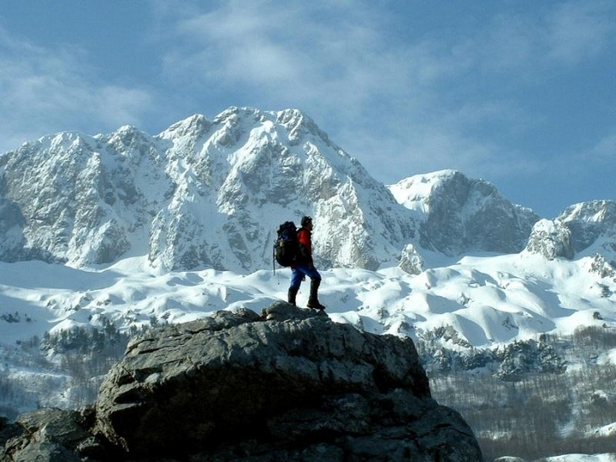
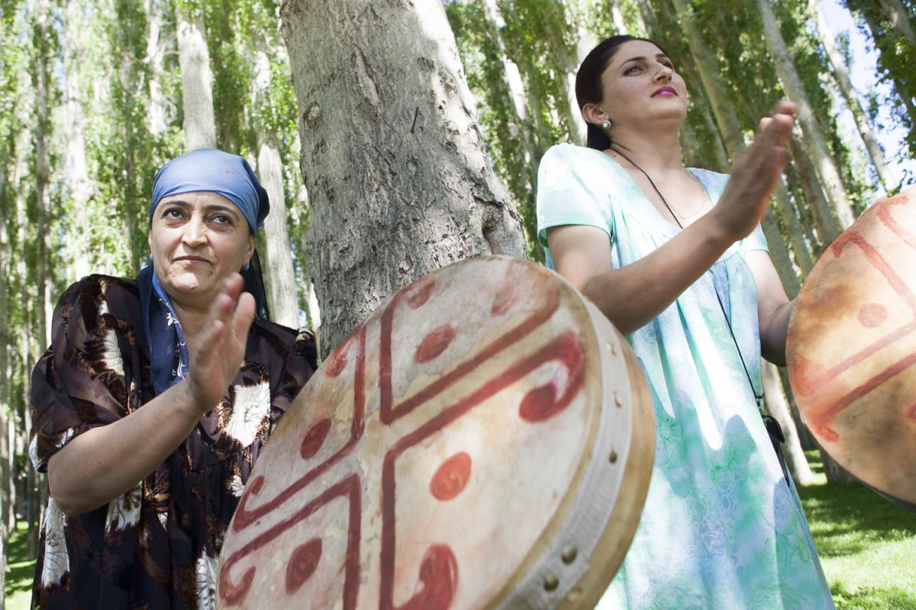
A trip along the Pamir Highway is certain to be a hit. This mountain highway connects the Pamir Mountains with Khorog, in Tajikistan, and Osh, in Kyrgyzstan. The highway covers a total of 1,325 km (825 miles), traveling along the borders with Afghanistan and China and reaching a high point at Ak-Baytal Pass, at 4,655 m (15,272 feet) above sea level. The Pamir Mountains are famous for their beautiful valleys and colorful mountain villages, where the lifestyle and traditions have been preserved until the modern day. Enjoy mountain vistas during the day, and bright starry skies at night.

Slide 4
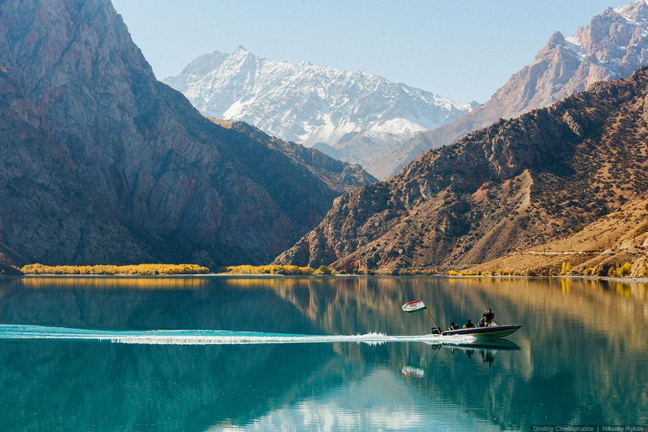
You can also take a trip to the Gissar Range, and enjoy a day (or more) on the shores of Iskanderkul, a gorgeous alpine lake named after Alexander the Great. The great warrior rested here with his army, next to the turquoise and dark lilac waters. Or take a hike through the Famm Mountains, with their own hidden lakes and spots.

Slide 5
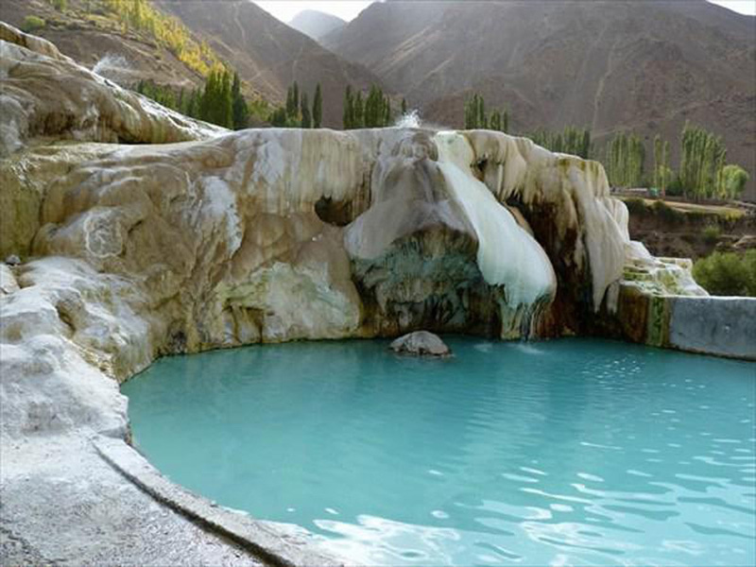
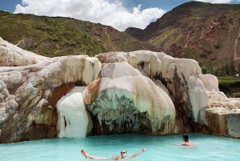
Tajikistan even has options for those who want to take care of their health. The Garm Chashma Hot Springs, not far from Khorog, has hot springs that reach 64 degrees C (150 F), and so many people swear by the mineral water that pilgrims often say that it is holy. The sanatorium offers services said to help with problems related to skin, muscles, bones, breathing, reproduction, and the cardiovascular system. Other mineral springs, including Khosguni, Chursh, and Zund produce carbonated water that can be used as a treatment.

Slide 6

Cultural-Historical Tourism
Even without visiting the many stunning natural places in Tajikistan, this country is still rich in historical and cultural sights. Tajikistan itself is an ancient state, home to Sogdiana and Bactria, and conquered by Alexander the Great and the Russian Empire. From fortresses to Buddhist temples to mosques and madrassas, Tajikistan has plenty of stories to tell to those who will listen.

Slide 7
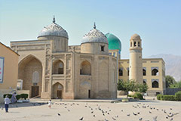
Khujand is a definite must-see in Tajikistan. Along with Bukhara and Samarkand, Khujand was once a center of science and culture in Central Asia, and many monuments from this golden age remain to this day. Visit the mausoleum of Sheikh Muslikhiddin and the Masjidi Jami Mosque, as well as the fortress built in Khujand’s inner city over 2,500 years ago.

Slide 8

Thank you for attention

